Slide 1
Lyft Driver Lifetime Assessment
Neville Joseph Roy

Slide 2

Table of Contents
Objective
02
Analysis of Lyft Drivers
09-10
Data Preprocessing
03-04
Factors Affecting Driver Activity
11-12
Calculation of Driver LTV
05-06
Factors Affecting Driver Churn
13-14
Factors Affecting Driver LTV
07-08
Actionable Insights
15
7

Slide 3
Objective
Deep dive into the data provided to recommend a Driver LTV, sharing interesting trends and insights on driver’s time on our platform.
2

Slide 4
Data Preprocessing
Three different datasets were provided; having the driver’s information, ride information and data related to the timing of the rides respectively.
To conduct an analysis of various cost components, extra columns were created to record rider cost without primetime as well as profit generated by lyft for each ride.
I employed formulas to accurately calculate the total cost of rides for riders. This included considerations for prime time pricing and applicable taxes specific to San Francisco.
Formulas Used:
Base Fare = $2.00 + (ride distance in miles) * $1.15 + (ride duration in minutes) * $0.22
Cost per ride = $1.75 + Base Fare + Base Fare * (ride prime time percentage) + Base Fare * (.085)
Lyft Profit = (Base Fare + Base Fare * (ride prime time percentage) ) *0.20
3

Slide 5
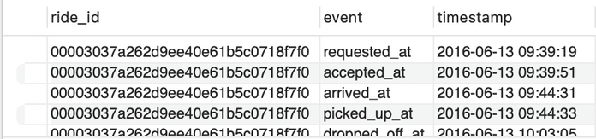
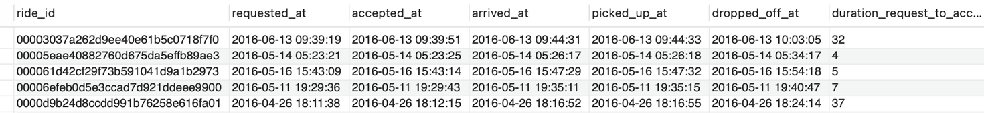
Data Preprocessing
To enhance organization, I transformed the dataset to eliminate duplicate ride entries. Additionally, created new columns to measure the time intervals between events, providing insights into rider wait times, driver pickup delays, and overall trip durations.
Finally the different datasets were merged into one master dataset that contained information about the ride, driver and time information to help in analysis.
4

Slide 6
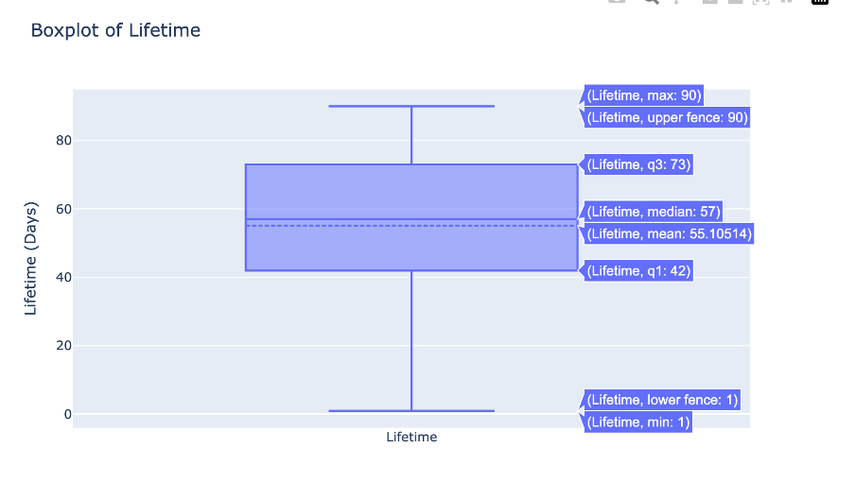
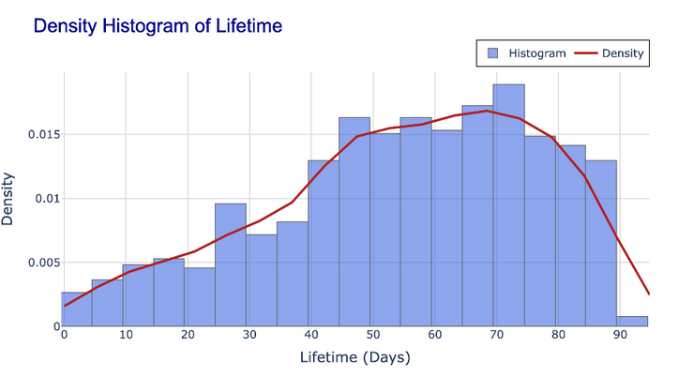
Calculation of Driver LTV
To calculate a Driver's Lifetime Value (LTV), which reflects the value of a driver to Lyft over their entire projected tenure, we first needed to identify the best representation of a typical driver’s lifetime.
To do this, we plotted a density histogram of driver lifetimes to analyze the distribution and assess whether the mean or median would be more accurate, considering any significant skewness or outliers.
Since the distribution was relatively normal, we concluded that while both mean and median values are viable, the median offers a more stable representation.
Based on the median, we project that once onboarded, a driver will typically remain active for about 57 days, guiding retention and planning strategies.
5

Slide 7

Calculation of Driver LTV
The daily revenue generated by drivers was calculated based on their active days and averaged across all drivers, then scaled to an annual figure by multiplying by 365.
To account for churn over the average driver tenure of 57 days, an 18.28% churn rate was applied, adjusted over the tenure period (in years) to reflect the impact of attrition on projected revenue.
Additionally, a 10%[2] discount rate was used to account for the time value of money, converting projected revenue into its present value and reflecting expected future revenue over a driver’s lifetime with Lyft.
Based on these adjustments, the estimated Driver Lifetime Value (LTV) for Lyft over the 57-day expected tenure is approximately $3,190.21.
The formula used to calculate Driver LTV:
6

Slide 8
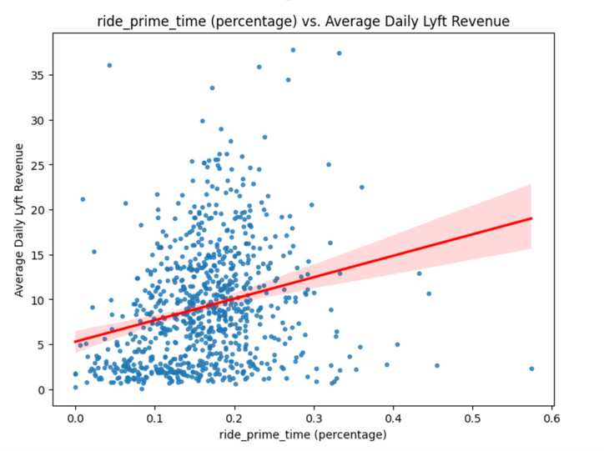
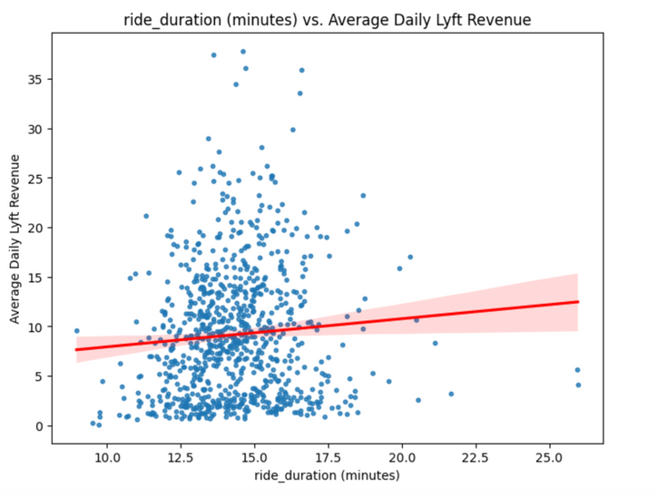
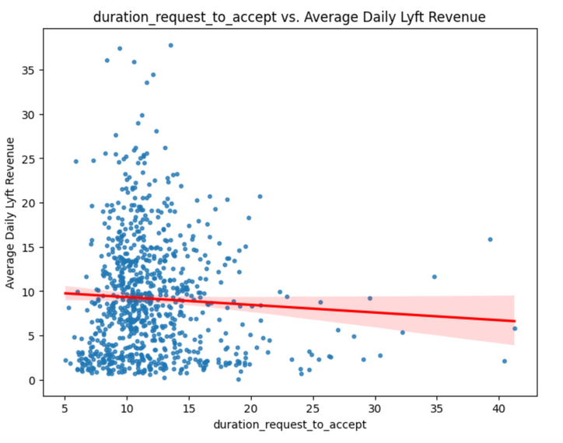
Factors Affecting Driver LTV
Key Factors affecting Driver LTV:
Prime time engagement
Ride Duration
Ride Acceptance Time
7

Slide 9



Factors Affecting Driver LTV
Analysis shows a strong positive correlation between prime time engagement and LTV, as drivers working during peak hours benefit from surge pricing. Implementing incentives to encourage drivers to increase their availability during these high-demand periods, would enhance driver earnings and overall revenue.
Analysis reveals a negative correlation between acceptance times and daily revenue, with faster responses linked to higher earnings due to increased ride completions. Lyft could implement a reward system for quick acceptance times, potentially boosting overall operational efficiency and driver revenue.
Analysis shows a positive correlation between trip duration and LTV with longer rides generating higher fares for both drivers and Lyft. Lyft could optimize dispatching to prioritize longer rides and incentivize drivers to accept them, boosting earnings for both parties.
8

Slide 10
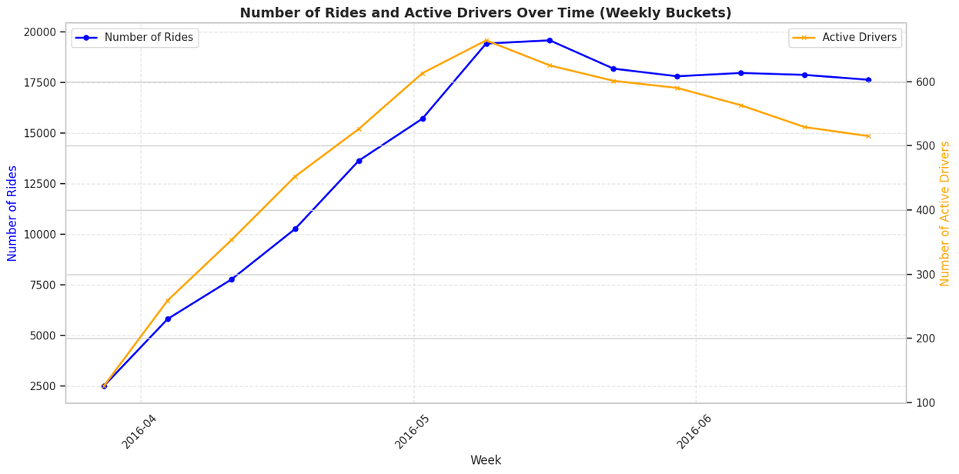
Analysis of Lyft Driver Data
On conducting an analysis on the change in the number of active drivers we observe:
That as the number of rides increases or decreases, the number of active drivers follows a similar pattern. This relationship suggests that driver activity is closely linked to rider demand, with fluctuations in demand likely influencing driver engagement levels.
For Lyft, this connection could mean that driver availability generally matches ride demand, which is essential for efficient service.
9

Slide 11
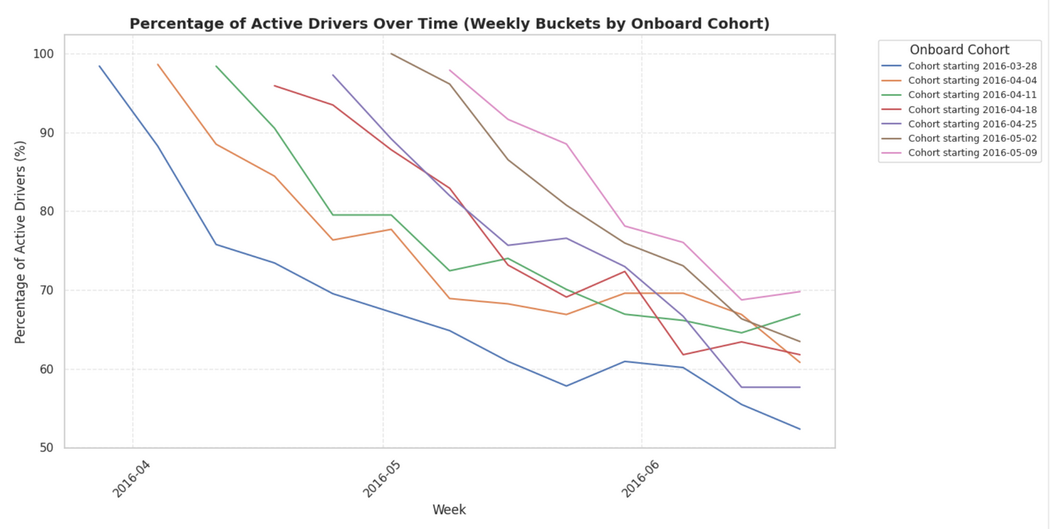
Analysis of Lyft Driver Data
Each driver cohort exhibits high activity levels in their initial weeks, followed by a gradual decline, indicating that new drivers tend to be more active at first before reducing their engagement.
While most cohorts show decreased activity over time, some maintain higher engagement levels, suggesting that specific factors may contribute to their sustained performance.
Understanding the reasons behind the decline in activity—such as job flexibility, earnings satisfaction, or retention challenges—can help Lyft design effective programs to enhance driver engagement.
10

Slide 12
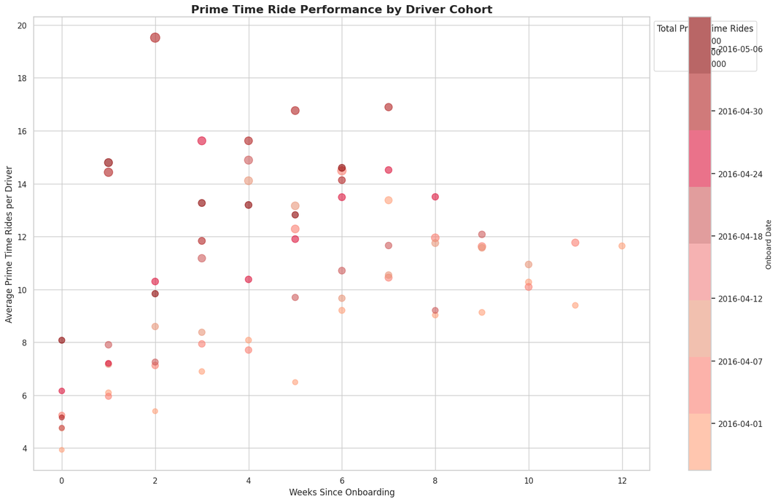
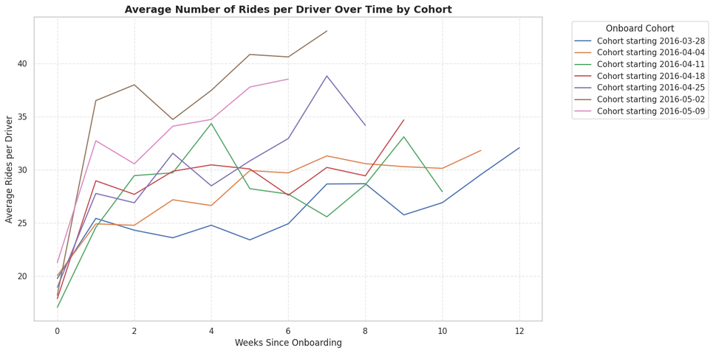
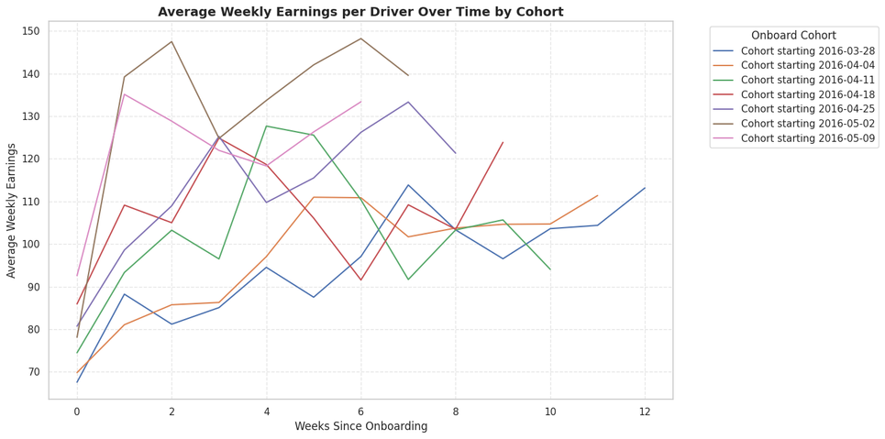
Factors Affecting Driver Activity
Key Factors affecting Driver Activity:
Ride count
Driver Earnings
Prime Time Ride
11

Slide 13



Factors Affecting Driver Activity
There is a general increase in the ride activity during the initial weeks after onboarding, but engagement patterns vary significantly by cohort, with some groups showing consistent growth while others fluctuate or plateau. This suggests that targeted incentives and re-engagement strategies around weeks 8-12 could help sustain driver activity and prevent declines over time.
The fluctuations in weekly earnings across cohorts suggest that driver earnings are influenced by variable factors like demand shifts, driver availability, which may require Lyft to implement more stable incentive programs to ensure consistent earnings over time.
The decline after the peak period suggests an opportunity for Lyft to introduce strategies, such as bonuses or flexible scheduling options, to encourage sustained prime-time engagement beyond the initial onboarding period.
12

Slide 14
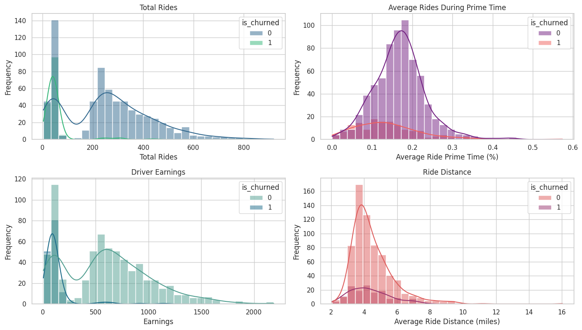
Factors Affecting Driver Churn
13

Slide 15

Factors Affecting Driver Churn
Total Rides
Prime Time Rides
Low-engagement drivers might be less committed or feel less connected to the platform, making them more susceptible to churn. Targeting this segment with engagement incentives, such as bonuses for a certain number of rides, may help retain them.
Drivers who don’t engage during peak hours may miss out on earnings from surge pricing, potentially impacting their satisfaction. Encouraging drivers to work during high-demand times through dynamic pricing incentives may improve retention in this segment.
Earnings
Ride Distance
Low-earnings drivers might feel that driving isn’t financially rewarding enough, leading them to churn. Lyft could offer tailored financial incentives or bonus structures to boost earnings for low-profit drivers.
Drivers preferring longer rides may achieve higher earnings per trip, leading to greater satisfaction and retention. Lyft could offer options to prioritize preferred ride types or create dispatch preferences to cater to drivers who favor either short or long trips.
14

Slide 16
Actionable Recommendations
Introduce Targeted Retention Incentives for New Drivers:
Implement targeted retention bonuses or incentives for new drivers around the 8-12 week mark to sustain engagement during the critical early stages as shown in the analysis. This could include bonuses for completing a minimum number of rides or incentives specifically for peak times.
Offer Flexible or Tiered Prime-Time Incentives:
Introduce flexible or tiered prime-time incentives that adjust based on the demand and driver engagement trends. This approach could make prime-time driving more attractive over the long term and prevent drop-offs in participation during peak hours.
Driver Loyalty Program:
As Drivers show a decline in activity over time, indicating that long-term engagement is challenging to maintain, introducing a loyalty program that rewards drivers for their tenure and consistent activity on the platform. This could foster a sense of belonging and motivate drivers to remain active longer.
15

Slide 17
Appendix
[1]. Additional Files.
[2]. 10% Discount rate is assumed for the calculation of Driver LTV.
[3]. All rides in the data set occurred in San Francisco.
[4]. All timestamps in the data set are in UTC.
[5]. The data is a snapshot of onboarding and ride history data for a 3 month period. You may assume the
data is complete for these drivers during the given time period; however, additional rides may have
occurred before and after the time period included in the data.
16
Thank You!

